Slide 1
Hyperspectral Urban Image Inpainting
Mingyuan Zhou
Zhengming Xing
Nov 10, 2009

Slide 2
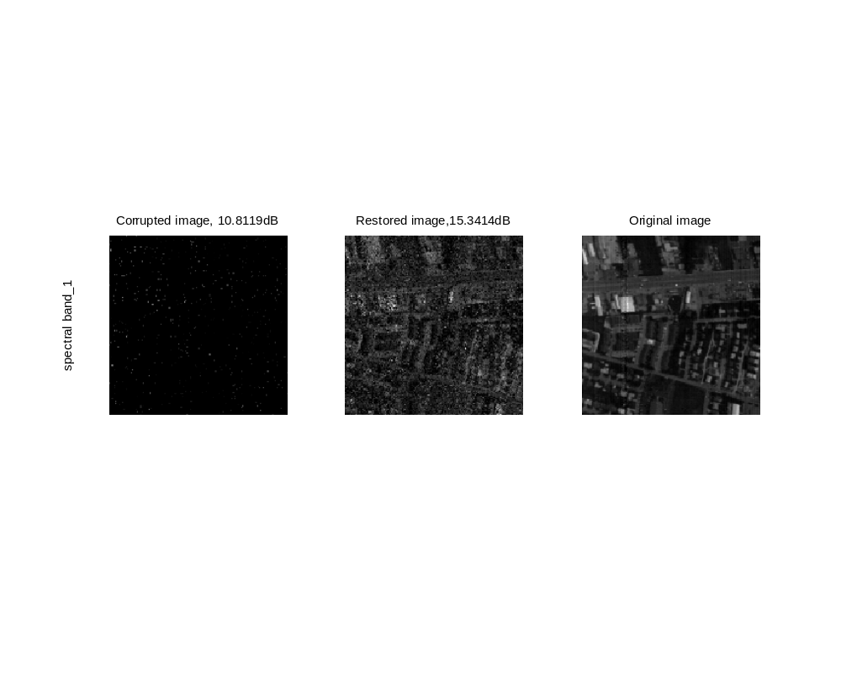
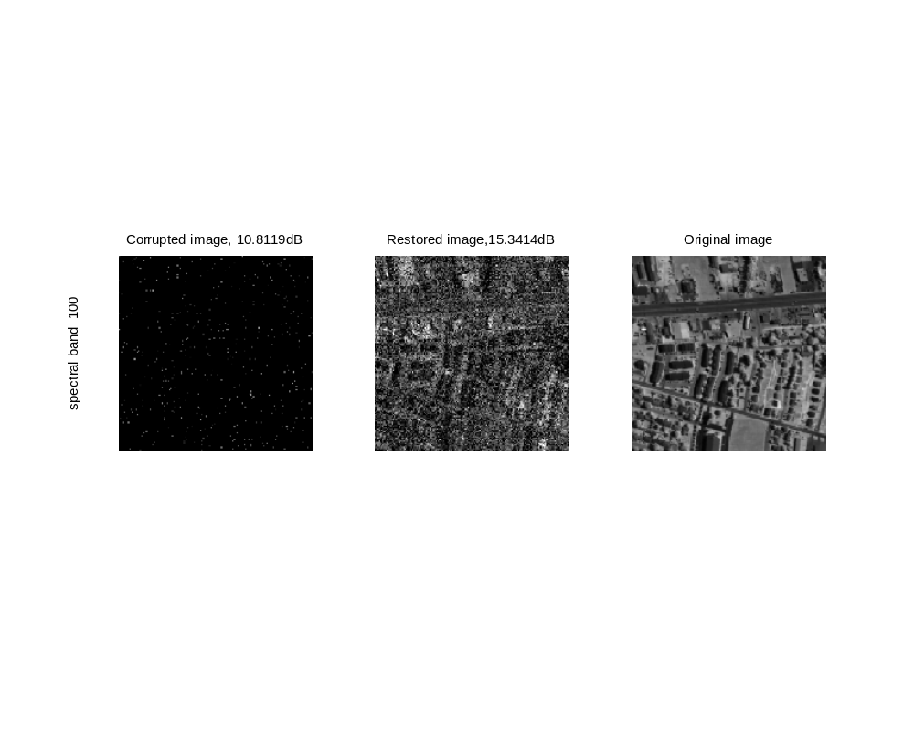
98% missing, Patchsize = 1*1

Slide 3
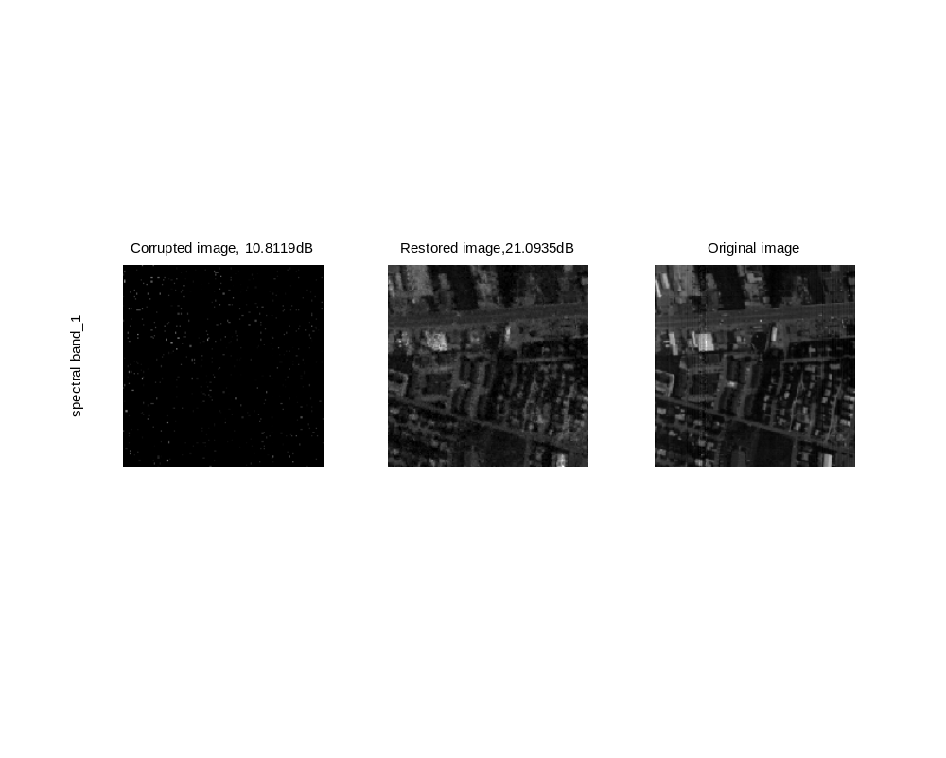

98% missing, Patchsize = 2*2

Slide 4


98% missing, Patchsize = 3*3

Slide 5


98% missing, Patchsize = 4*4

Slide 6


98% missing, Patchsize = 5*5

Slide 7


98% missing, Patchsize = 6*6

Slide 8


98% missing, Patchsize = 7*7

Slide 9
98% missing, Patchsize = 8*8

Slide 10


95% missing, Patchsize = 1*1

Slide 11


95% missing, Patchsize = 2*2

Slide 12


95% missing, Patchsize = 3*3

Slide 13


95% missing, Patchsize = 4*4

Slide 14


95% missing, Patchsize = 5*5

Slide 15


95% missing, Patchsize = 6*6

Slide 16


95% missing, Patchsize = 7*7

Slide 17


95% missing, Patchsize = 8*8

Slide 18


90% missing, Patchsize = 1*1

Slide 19


90% missing, Patchsize = 2*2

Slide 20


90% missing, Patchsize = 3*3

Slide 21


90% missing, Patchsize = 4*4

Slide 22


90% missing, Patchsize = 5*5

Slide 23


90% missing, Patchsize = 6*6

Slide 24
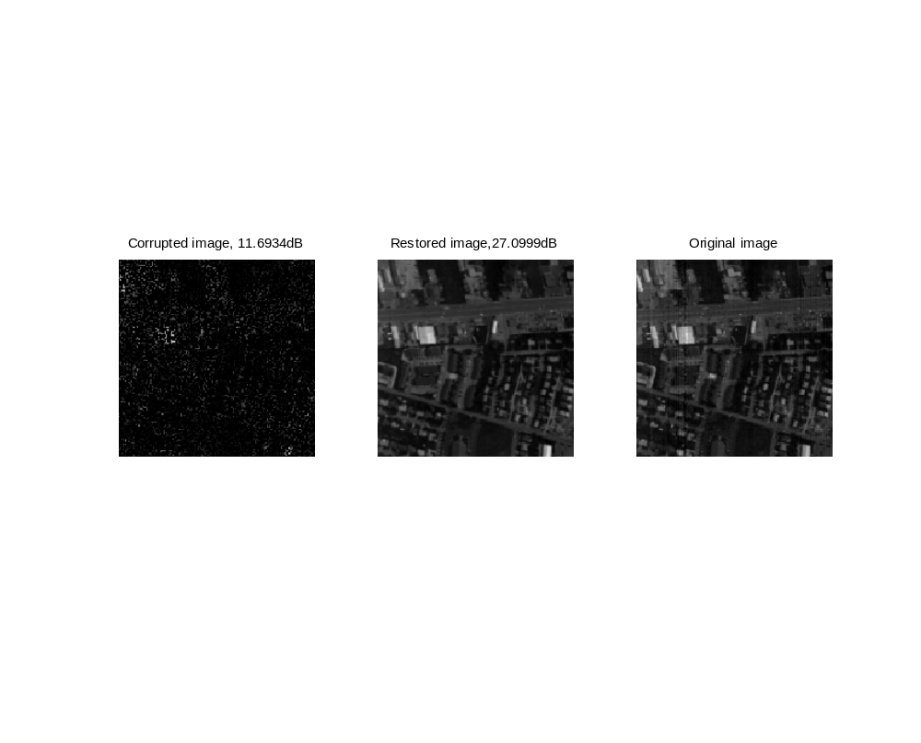

90% missing, Patchsize = 7*7

Slide 25
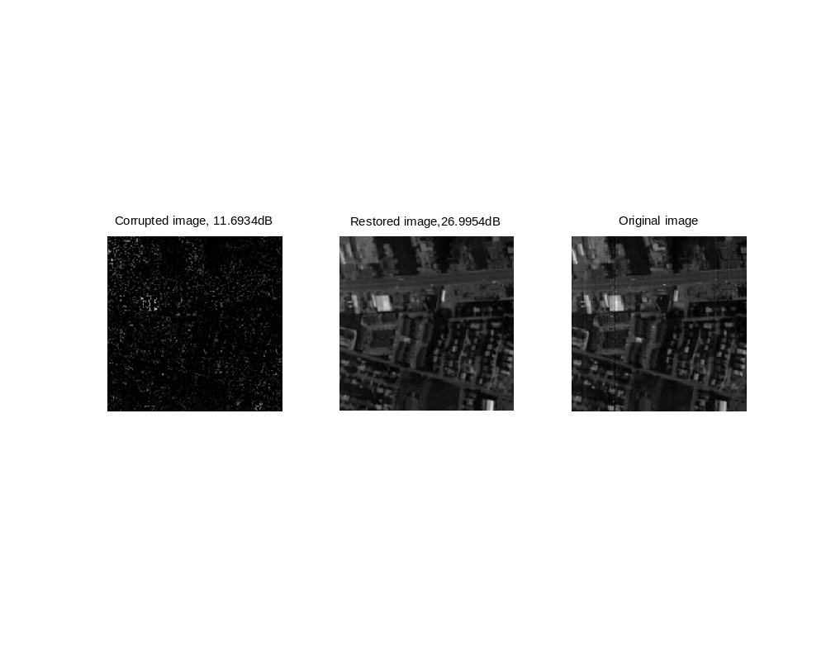

90% missing, Patchsize = 8*8

Slide 26


80% missing, Patchsize = 1*1

Slide 27


80% missing, Patchsize = 2*2

Slide 28


80% missing, Patchsize = 3*3

Slide 29


80% missing, Patchsize = 4*4

Slide 30


80% missing, Patchsize = 5*5

Slide 31


80% missing, Patchsize = 7*7

Slide 32


80% missing, Patchsize = 8*8

